Slide 1

Week2:
Basis of Deep Learning & Regression
Machine Learning Using Tensorflow
Shu-Ting Pi, PhD
UC Davis

Slide 2
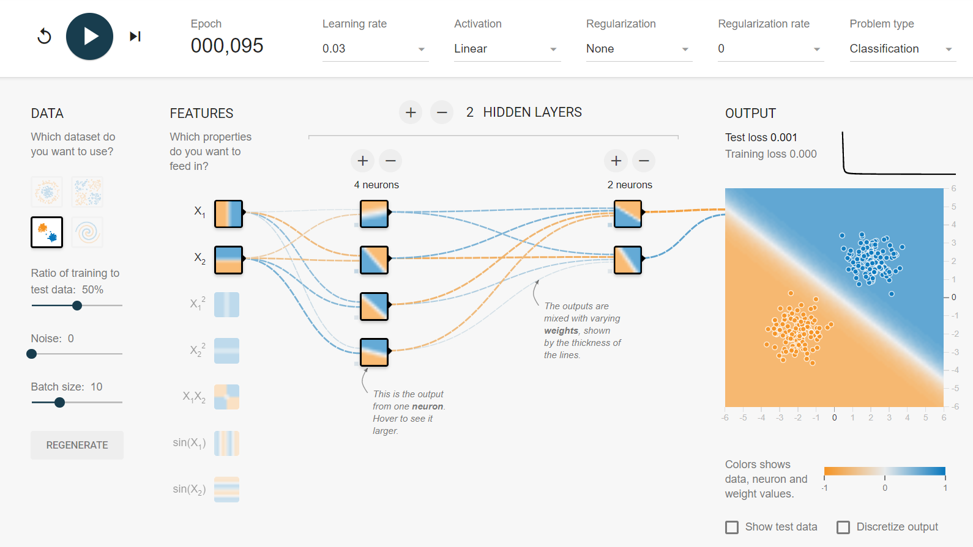
Tensorflow Playground
TF playground is particular useful to give you some hints to fine tune the parameters of your network.
Machine Learning using Tensorflow
Shu-Ting Pi

Slide 3

linear neural network
h1
x1
x2
x3
- Only works for linear separable data
- multilayer structure is meaningless !
Machine Learning using Tensorflow
Shu-Ting Pi

Slide 4

Nonlinear neural network
bias
1
bias
1
Biases: sensitivity of the node
Activation function: nonlinearlize the inputs
Machine Learning using Tensorflow
Shu-Ting Pi

Slide 5
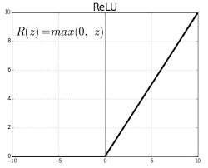
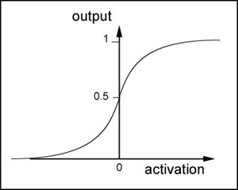
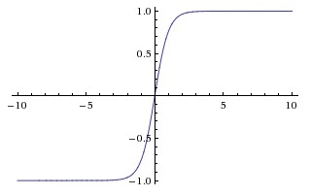
Activation functions
How to nonlinearize? Think about human neural network!
Relu
Sigmoid
tanh
Neural nodes become “active” after the input if higher than a threshold
and become “numb” if input is too high (sigmoid & tanh).
Machine Learning using Tensorflow
Shu-Ting Pi

Slide 6
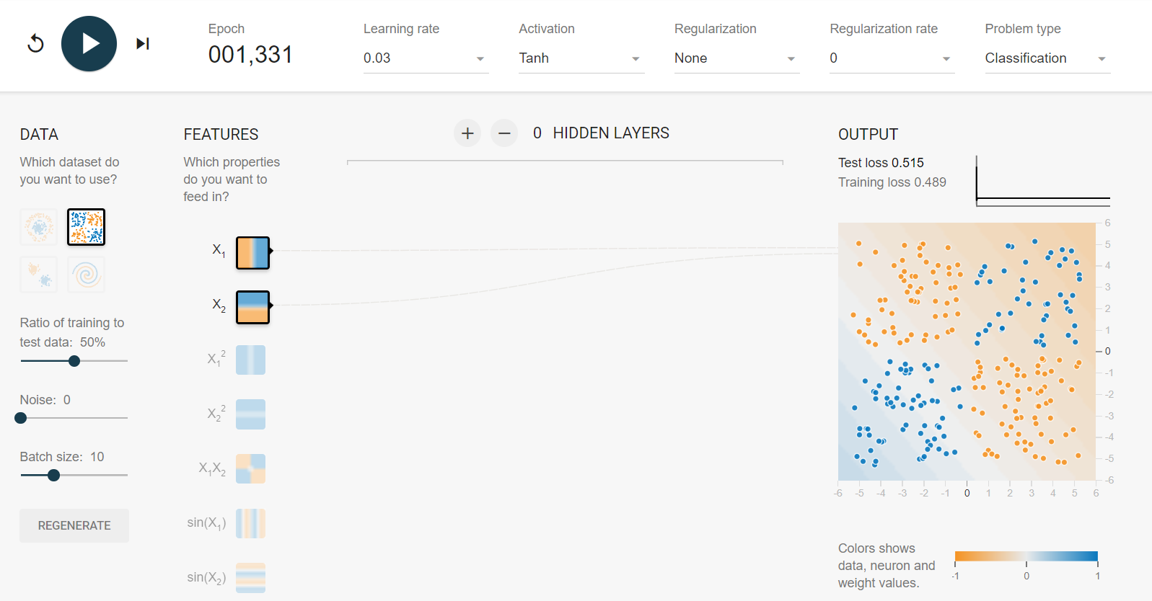
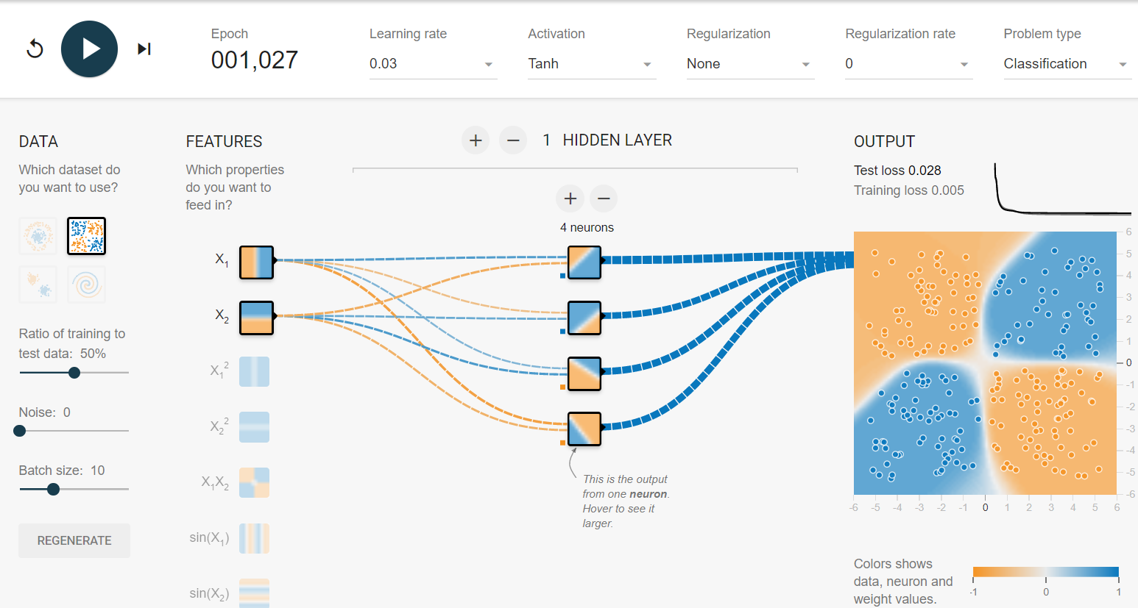
Why multilayer?
It is proven that single layer NN can not solve “XOR” problem!
Don't dig into the math, let's prove it using tensorflow playground!
Machine Learning using Tensorflow
Shu-Ting Pi

Slide 7
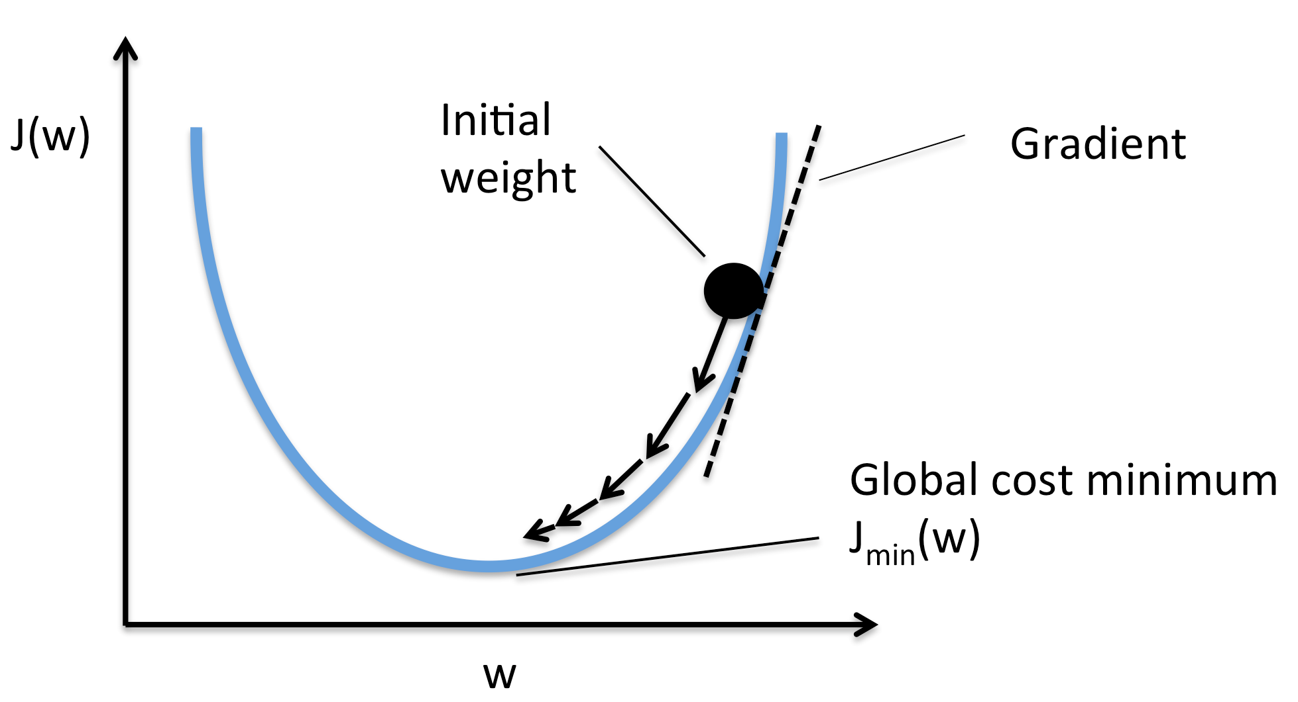
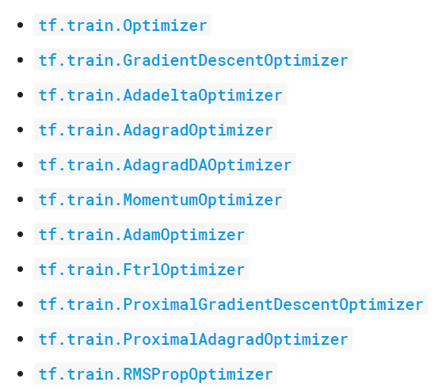
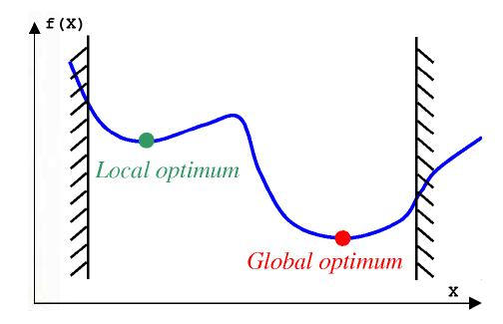
Optimizer
Alpha go!
Machine Learning using Tensorflow
Shu-Ting Pi

Slide 8
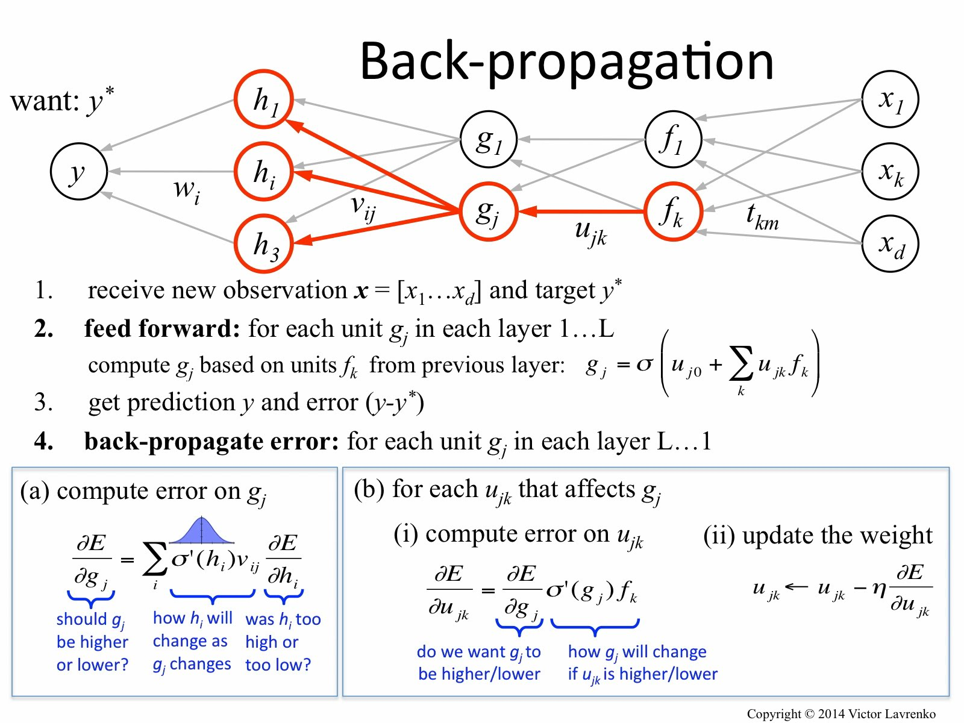
Back propagation
Machine Learning using Tensorflow
Shu-Ting Pi

Slide 9
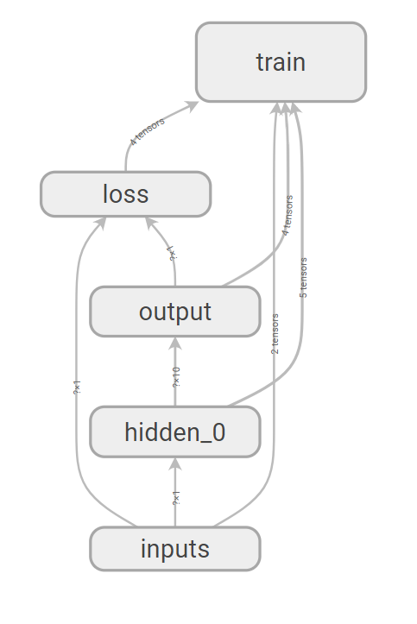
How does tensorflow work?
Construct computation graph
  - tf.Variable: variables, default: trainable
  - tf.constant: set up constant array
  - tf.placeholder: feed until session
  - tf.layers.dense: create nn layers
  - tf.train.GradientDescentOptimizer: train scheme
Machine Learning using Tensorflow
Shu-Ting Pi

Slide 10
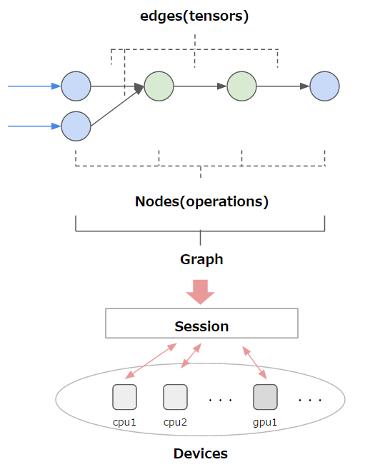
Tensorflow session
Make tensors flow
  - tf.global_variables_initializer()
    Initial values assignment operator
  - tf.Session()
    Tensorflow session create
  - tf.Session.run( , feed_dict={} )
    Evaluate results on particular object
Machine Learning using Tensorflow
Shu-Ting Pi

Slide 11
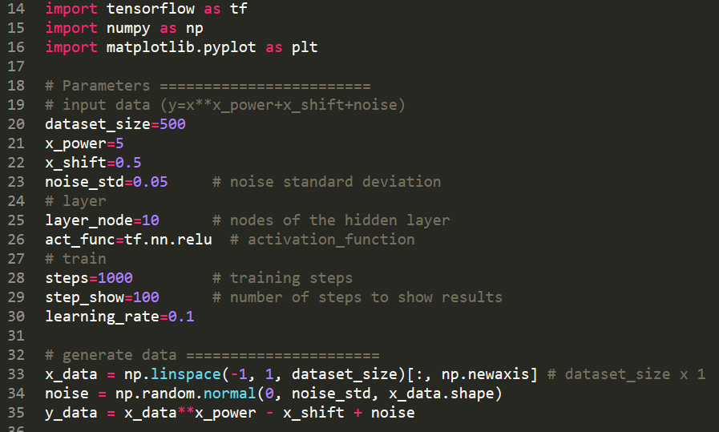
Input data
Machine Learning using Tensorflow
Shu-Ting Pi

Slide 12
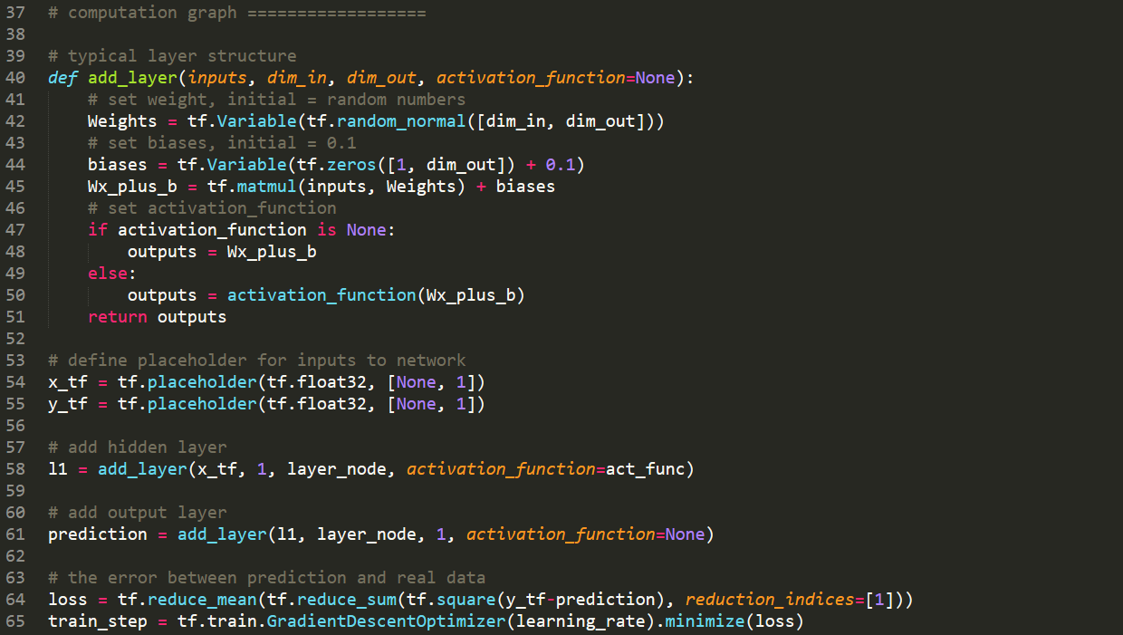
Compution graph
Machine Learning using Tensorflow
Shu-Ting Pi

Slide 13
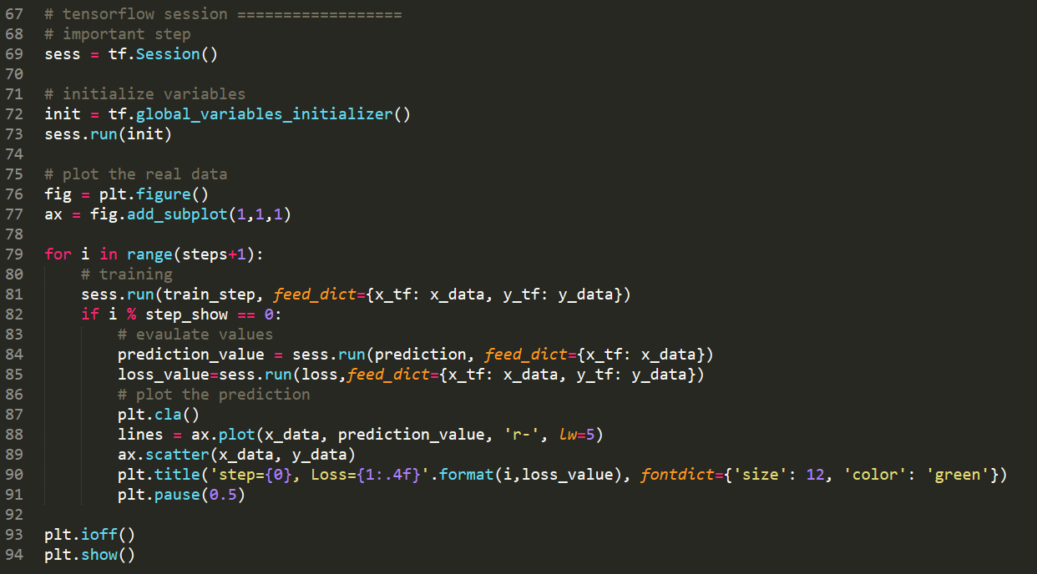
Tensorflow session
Machine Learning using Tensorflow
Shu-Ting Pi

Slide 14
Extra Exercise
Improve the code:
  code02_2: using batch data set to train NN
  code02_3: using tf.dense.layer to generate NN
Questions:
  Try change activation functions, number of nodes
  Will you always get better results by increasing number of nodes?
Machine Learning using Tensorflow
Shu-Ting Pi

